Slide 1
Detecting Pneumonia from Chest X-Rays
Ankush Saini
Anantvir Singh

Slide 2
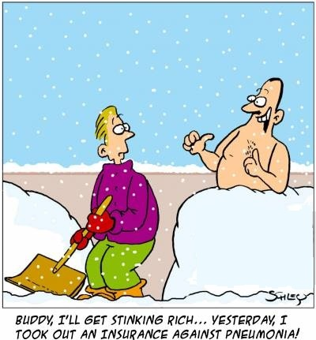
Pneumonia
Very common lung disease
More than 3 million cases every year in US and 50,000 deaths
Diagnosis ?
From Chest X-rays(CXR) --> It’s very complicated and needs highly trained specialists
There are usually other conditions in lungs like fluids, volume loss, surgical changes, fluid outside the lungs appears opaque on CXR

Slide 3

Detecting Pneumonia
Can it be automated ?
Very common, so we have lot of data
We can learn from it !
Many Machine Learning algorithms can be used
We will use Deep Learning (Works best with image data)

Slide 4

Recap: Image Classification using Deep Learning
Build an image classifier
Library - PyTorch, OpenCV
Convolutional Neural Networks

Slide 5
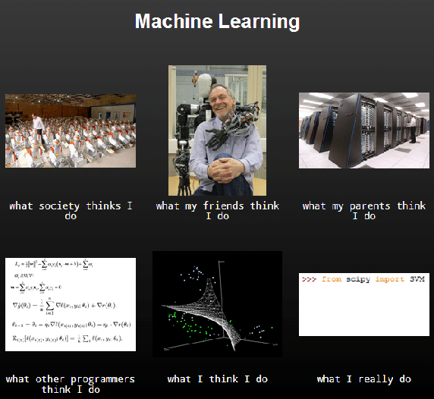
State of the Art
CheXNet: Radiologist-Level Pneumonia Detection on Chest X-Rays with Deep Learning from Stanford ML Group
121 Layered Convolutional Neural Network trained on 100,000 Chest X rays
Detected 14 diseases
Accuracy better than radiologist
Localization using class activation maps
Link to Paper

Slide 6
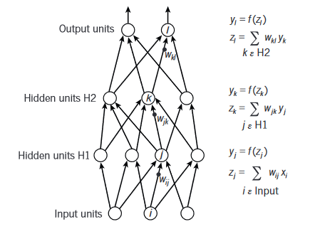
Neural Network
Forward Propagation Yann LeCun, Yoshua Bengio & Geoffrey Hinton https://www.cs.toronto.edu/~hinton/absps/NatureDeepReview.pdf

Slide 7
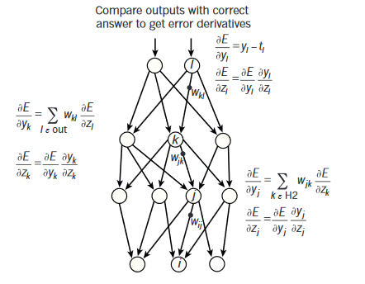
Neural Network
Backpropagation
Calculate difference in true value and value predicted by our network
Define error function
Compute gradient w.r.t all weights(edges) in the network
Propagate the error backward using derivative chain rule
Update weights https://www.cs.toronto.edu/~hinton/absps/NatureDeepReview.pdf

Slide 8
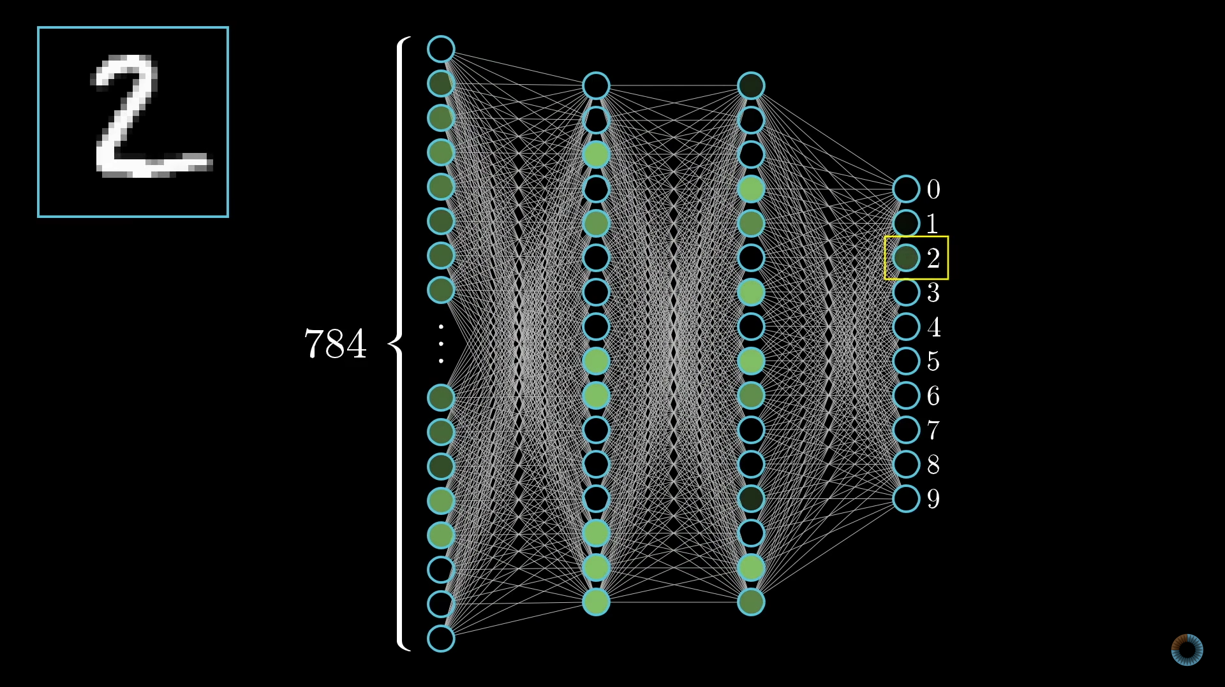
Neural Networks

Slide 9
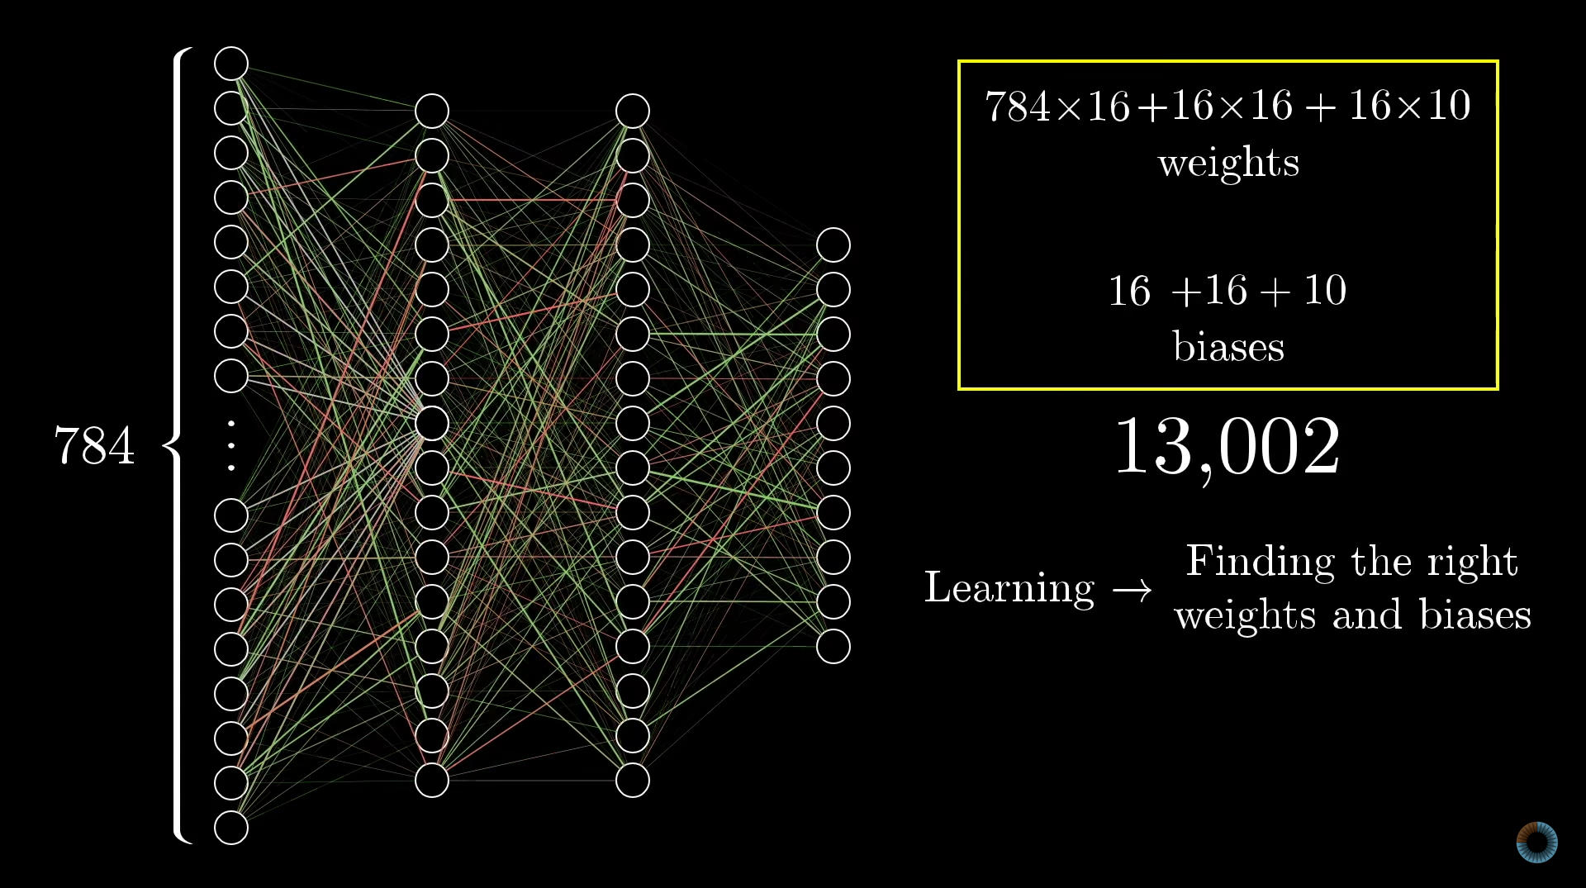
Neural Network
Why training them is hard ?
Our model has 1,423,418

Slide 10
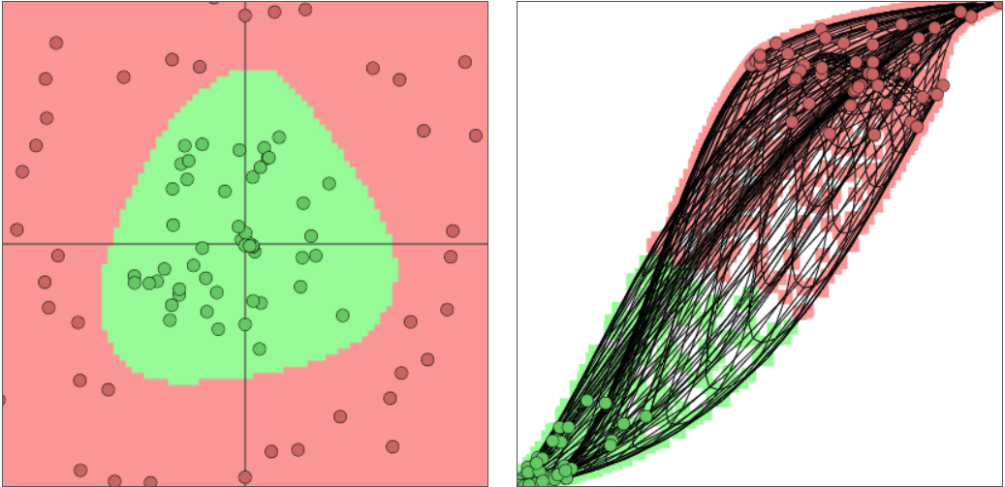
Neural Network (Decision Boundary)
https://cs.stanford.edu/people/karpathy/convnetjs//demo/classify2d.html

Slide 11
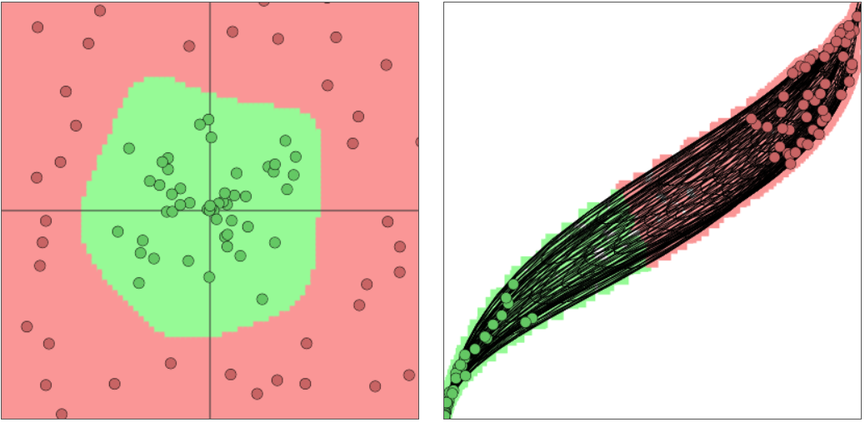
https://colah.github.io/posts/2014-03-NN-Manifolds-Topology/

Slide 12
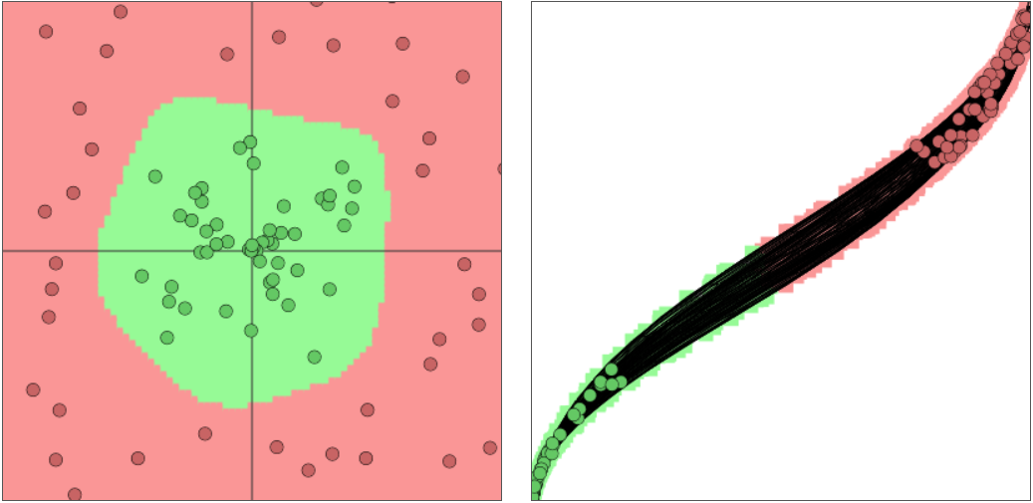

Slide 13
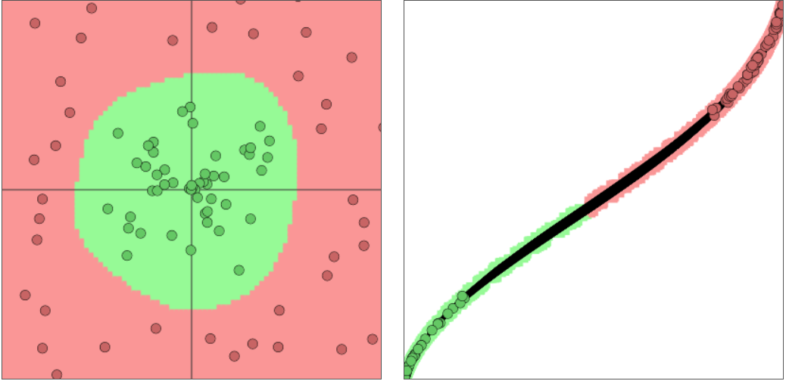

Slide 14
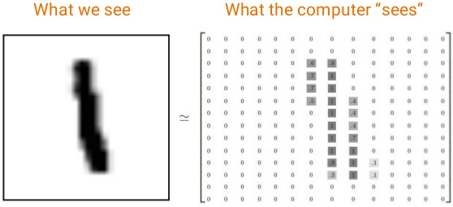
Image Classification
Take input image
Feed it to a Neural Network
Output a class i.e a digit, cat, dog, Pneumonia, Normal etc.

Slide 15
What we want computer to do
How we see images ? Focus on a particular identifiable features
Example dog 4 paws, 2 ears etc, or
We want computer to focus on such features of an image
First focus on low level features like edges, corners etc.
Then detect more high level features like face, legs, ears etc.
How to do this ?

Slide 16

Convolutional Neural Networks
General CNN Architecture

Slide 17
Our CNN
Convolutional Layers → 6
Max Pooling Layers → 6
Drop Out Layers → 6
Global Average Pooling Layer → 1
Fully Connected Layers → 2
Optimizer → ‘Adam’

Slide 18
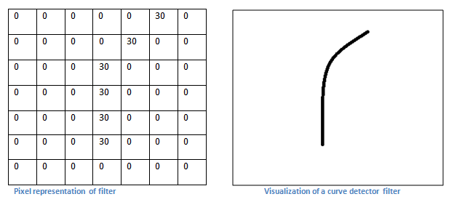
Convolutional Neural Networks(CNN)
Curve detecting filter
https://adeshpande3.github.io/adeshpande3.github.io/

Slide 19
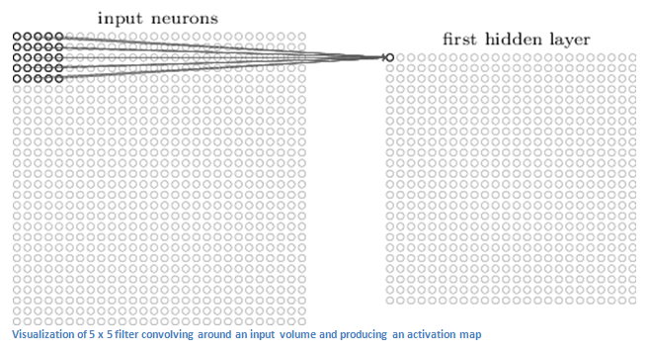
CNN
https://adeshpande3.github.io/adeshpande3.github.io/

Slide 20
CNN
Visual Interpretation
http://setosa.io/ev/image-kernels/

Slide 21

Convolutional Layer
Originl CNN Paper (Yann LeCun, Yoshua Bengio & Geoffrey Hinton) http://yann.lecun.com/exdb/publis/pdf/lecun-01a.pdf

Slide 22
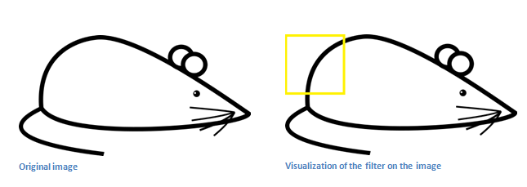
Convolutional Layer
Apply the curve detection filter to this image

Slide 23
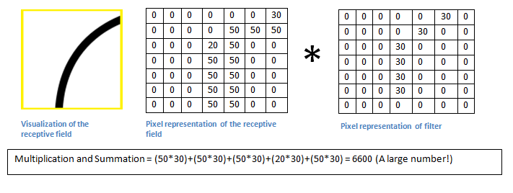
Convolutional Layer
Large value of convolution means the filter has detected a curve

Slide 24
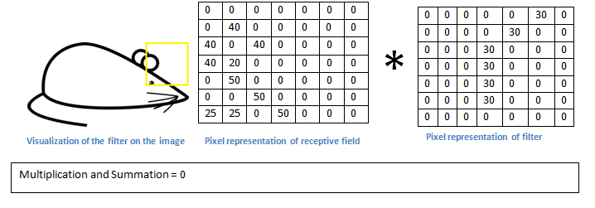
Convolutional Layer
Convolution = 0, because there is nothing in the image which responded to curve detector filter

Slide 25
Convolutional Layer
Output of convolutional layer is called ‘Activation Map’
Activation Map will show the areas in which there are most likely to be curves in the input image
This is just one filter to detect curves
We can have multiple filters to detect lines which curve to the right, or which detect circles etc.
More filters → More information we have about image

Slide 26

Convolution Visualization

Slide 27
CNN
Output of 1st Conv. layer becomes input of 2nd conv. layer
i.e for 2nd layer the input is activation map which resulted from first layer
So each layer will represent locations of some low level features of input image
As we apply more filters, the output will represent more higher level features
By end of the network you may have some filters which activate when there is handwriting in image, a dog, a X-ray with Pneumonia.
Visualization :- http://scs.ryerson.ca/~aharley/vis/conv/flat.html

Slide 28
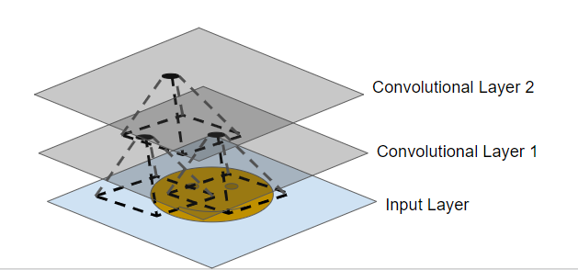
CNN
Each neuron only connected to receptive field of previous layer
So less parameters, less training time

Slide 29
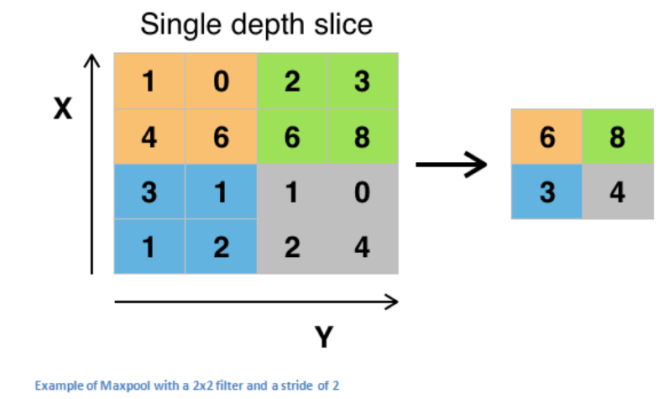
Pooling Layer
Reduces size of input data → Reduces number of parameters
Has several other options, maxpooling is most common
Once we know that particular feature exists in the image, its location relative to other features does not matter
Reduces number of parameters
by 75% → Less computational cost

Slide 30
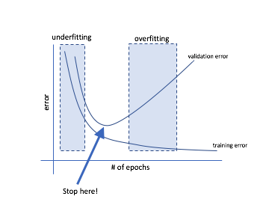
Dropout Layer
To prevent overfitting, this layer randomly “Drops Out” some activations in that layer by setting them to zero
The proportion of Dropout can be specified by user
We used 0.15
Results in better generalization

Slide 31
Fully Connected Layer(Dense Layer)
Works like a normal Neural Net. Input → High level features from previous layer
It looks at output of previous layers
Determines which features belong to which class
Learns weights accordingly through backpropagation by minimizing error function using Stochastic Gradient Descent
Outputs a particular class i.e car or bus, Pneumonia or Normal

Slide 32
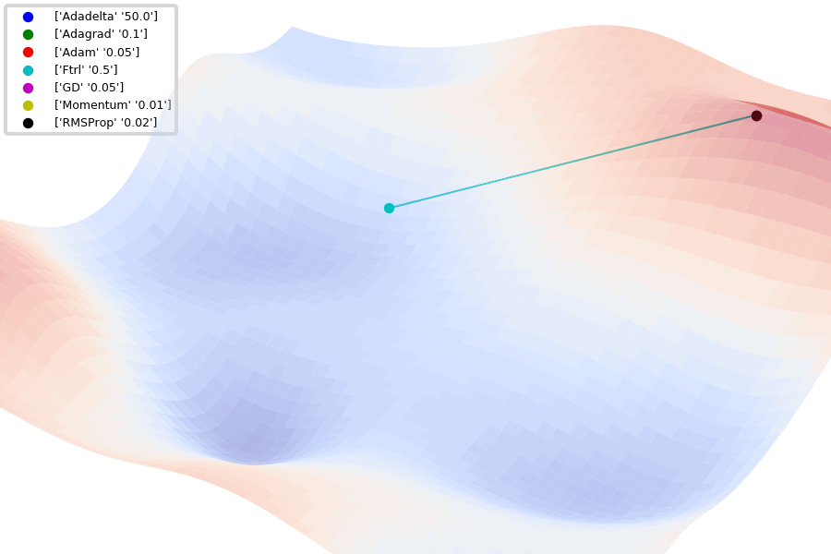
Error Surface
https://github.com/Jaewan-Yun/optimizer-visualization

Slide 33

Tensorflow
Uses dataflow graph to represent computation In terms of operations, Variables & Placeholders
Each node is an operation
Dependencies between operations given By edges ⇒ Possible to partition program Across multiple CPU’s, GPU’s or TPU’s
Lazy execution i.e first build the entire graph, then run graph through session
Keras → Easy to use high level API built on Tensorflow
https://www.tensorflow.org/guide/graphs#what_is_a_tfgraph

Slide 34
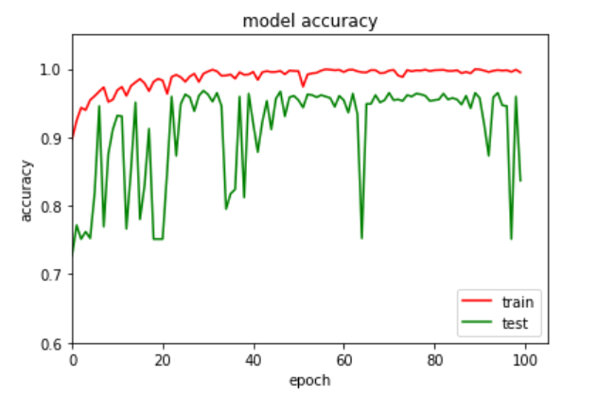
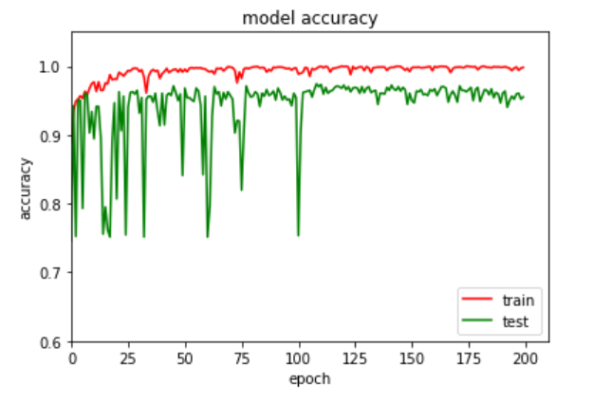

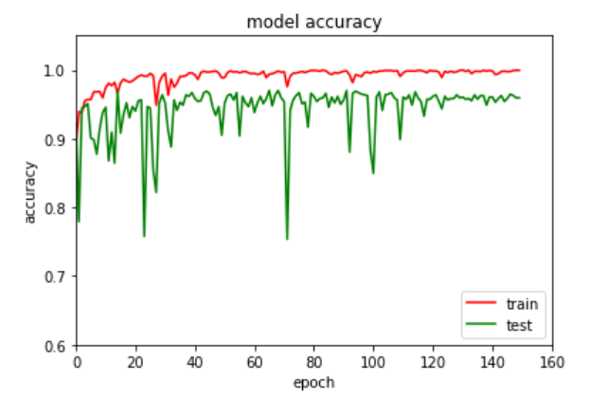
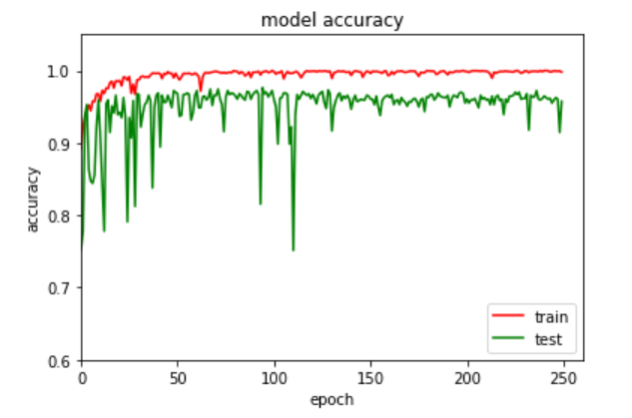
Results(Accuracy)
Epochs = 100
Epochs = 200
Epochs = 150
Epochs = 250

Slide 35
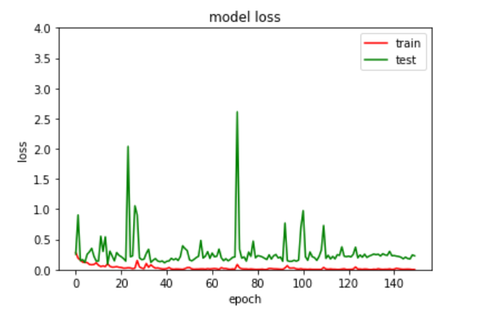
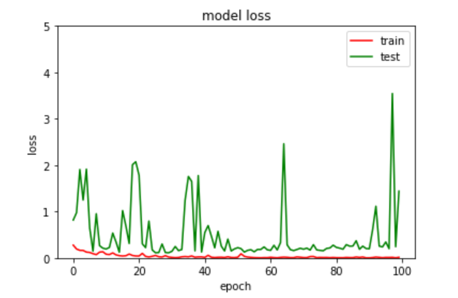
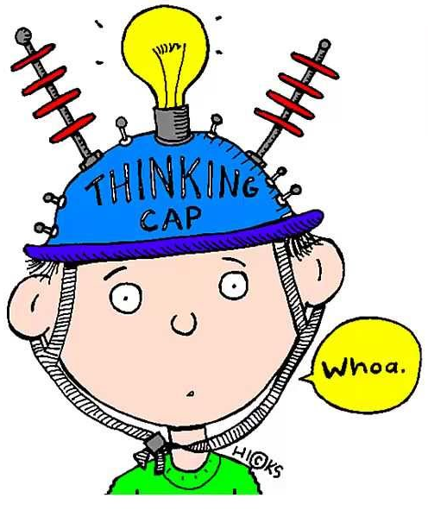
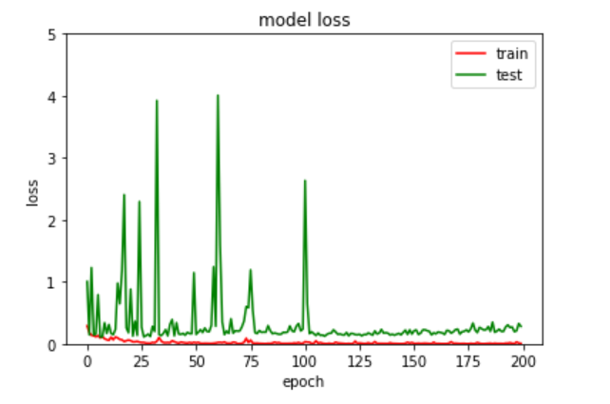
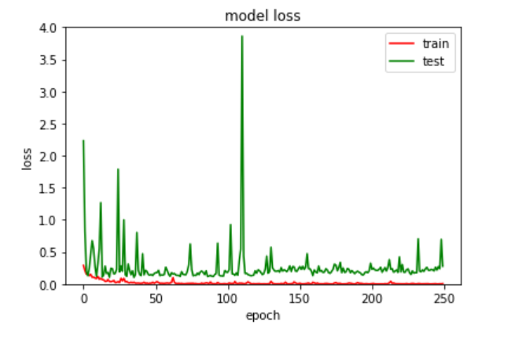
Error
Epochs=200
Epochs=100
Epochs=150
Epochs=250

Slide 36
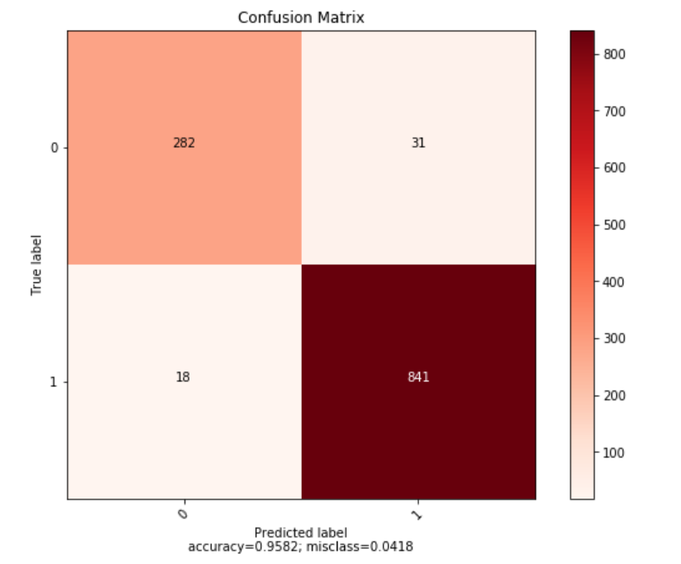
Confusion Matrix
250 Epochs

Slide 37
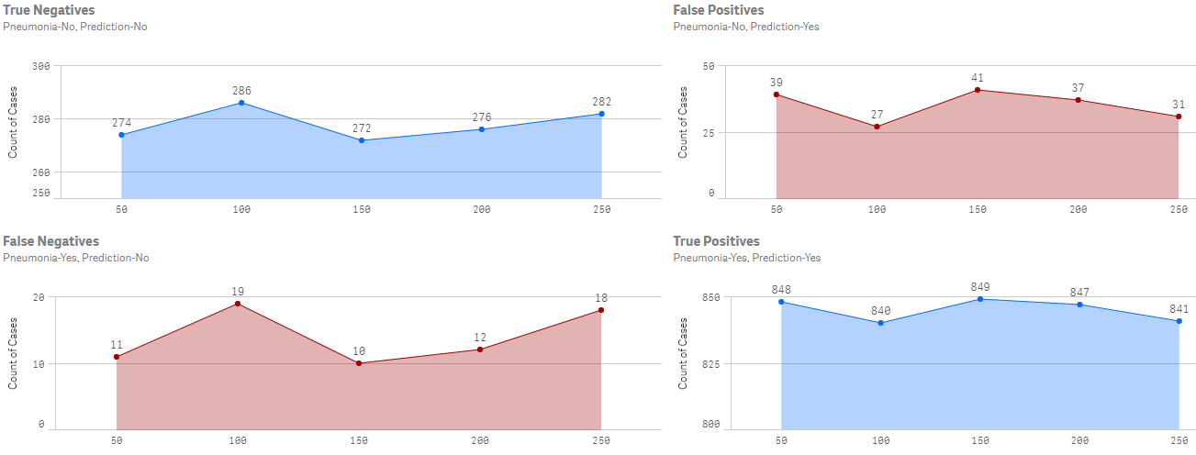
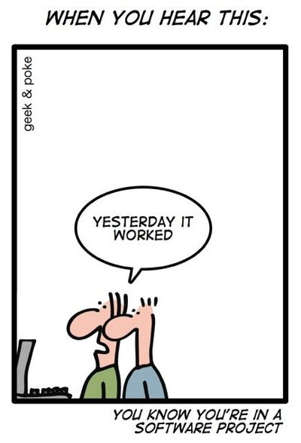
Confusion Matrix Comparison

Slide 38
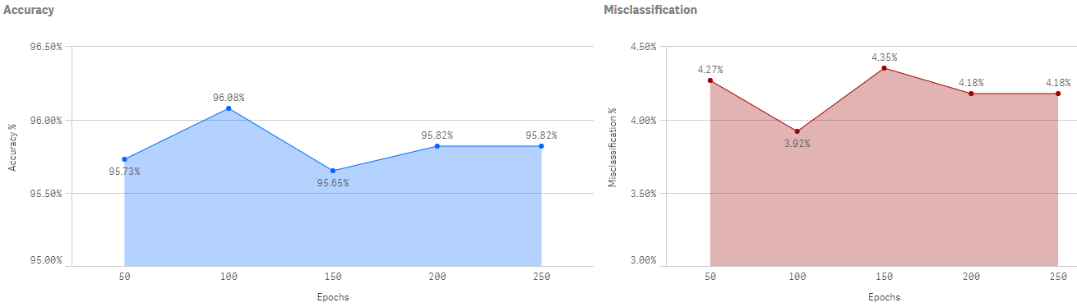
Accuracy % & Misclassification % Comparison

Slide 39
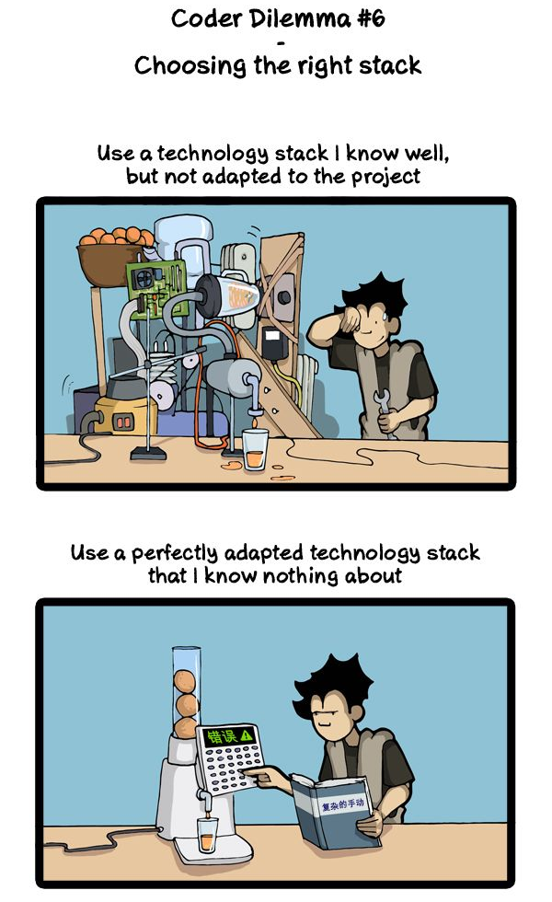
Package | Version
Processor | Intel Core i7 8750H
RAM | 16 GB
Graphics Card | Nvidia GTX 1060 Max-Q (6 GB)
Hard Drive | 128 GB SSD
Operating System | Windows 10
Qlik Sense | 2019-01-17T15:04:54.430Z
scikit-learn | 0.20.3
Package | Version
numpy | 1.16.2
pandas | 0.24.2
pillow | 5.4.1
matplotlib | 3.0.3
opencv | 3.4.1
keras | 2.2.4
tensorflow | 1.13.1
python | 3.6.8

Slide 40
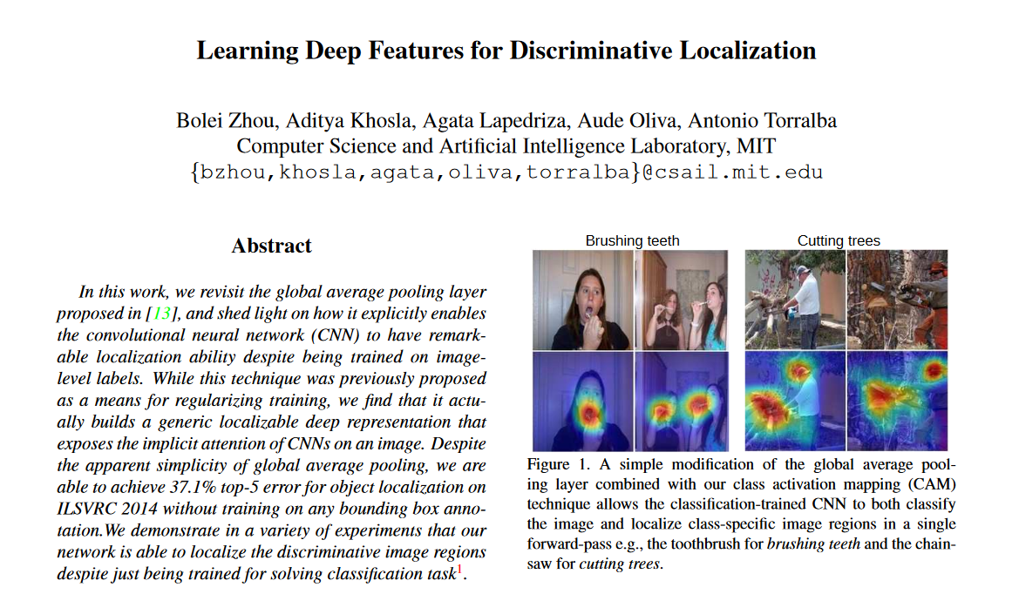
Future Work
Localize Pneumonia in the image
http://cnnlocalization.csail.mit.edu/Zhou_Learning_Deep_Features_CVPR_2016_paper.pdf

Slide 41
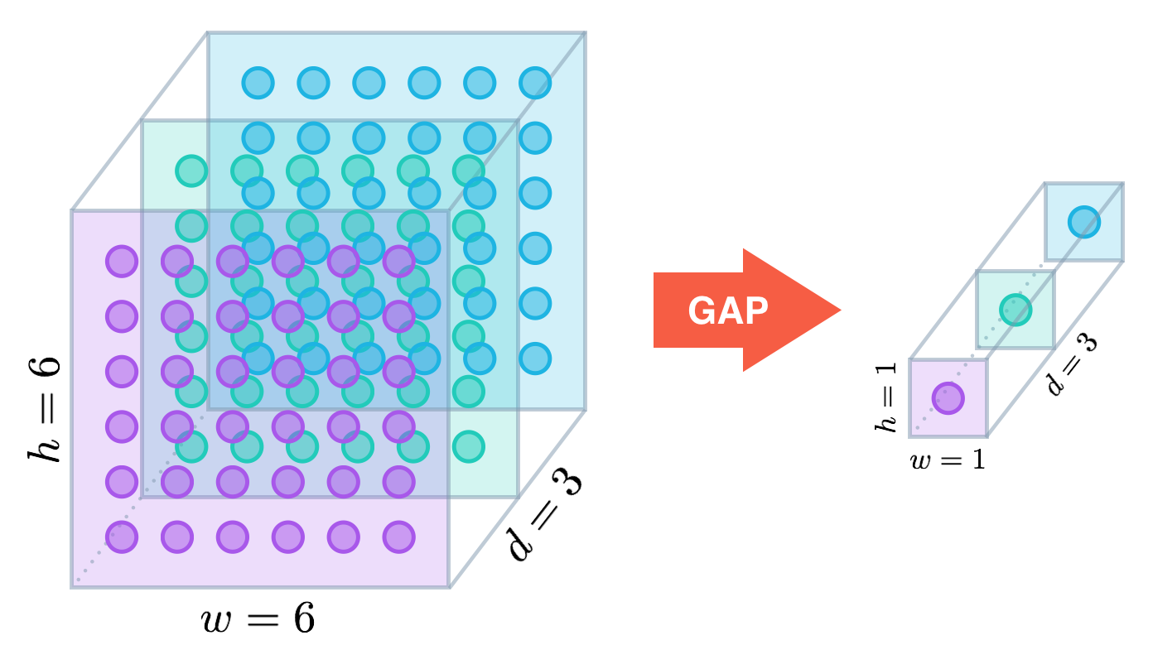
Future Work
Take the activation map from final Global Average Pooling(GAP) layer
Localization is this activation map expressed as Heat Map

Slide 42
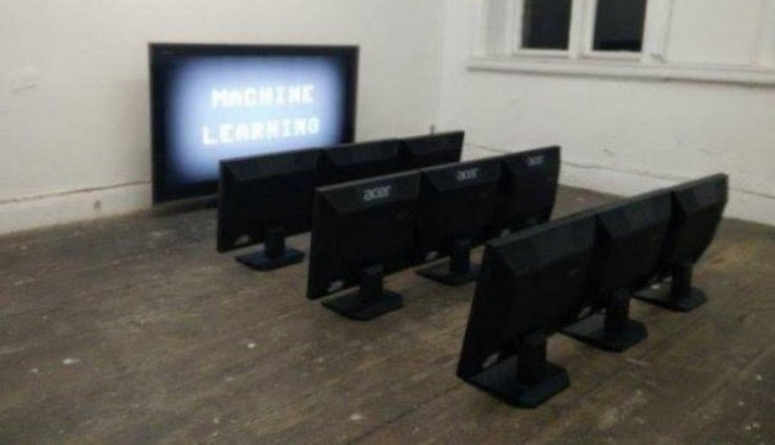
Thank you

